Slide 1

Fake News Detection
Using Machine Learning
Naive Bayes Approach for Binary Text Classification
WELFake Dataset
TF-IDF + MultinomialNB
01

Slide 2
Presented By:
Fatima Fiaz (017)
Khadijah Irfan (025)
Zujajah Khan (031)
Momina Aadil (053)
05

Slide 3
Project Overview
• Fake news spreads rapidly through social media and online platforms.
• Manual verification is slow, expensive, and not scalable.
• Machine learning can automatically classify news text as real or fake.
Why automatic fake-news detection is useful
02

Slide 4
Project Type
ML
Machine Learning Project
The system learns from labeled examples: each news article has a known class label.
✓
Supervised Learning
TXT
Text Classification
03

Slide 5
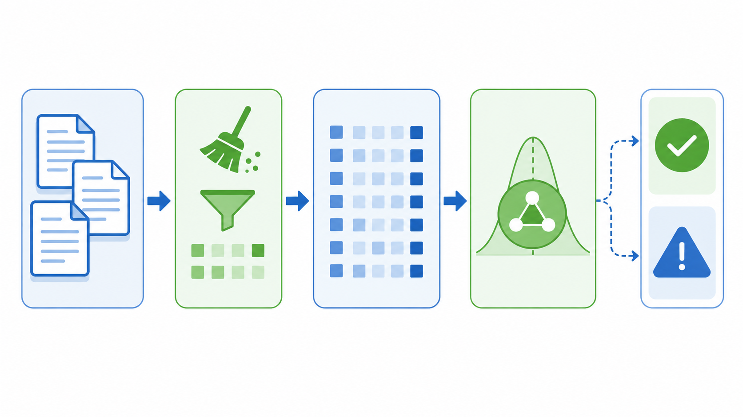
Dataset Name
WELFake Dataset
• A combined fake-news dataset from multiple sources.
• Contains news articles and corresponding labels.
• Used as the foundation for training the classifier.
04

Slide 6
Dataset Type
The project uses textual data, not visual/image data
• CSV file
• Article text stored as strings
• No image/video processing involved
• Natural Language Processing
• News article content
• Binary class label for each row
Input format
Data focus
05

Slide 7
Class Type
Binary classification: two possible outputs
Output
REAL / FAKE
0
1
Real News Label
Fake News Label
• The model learns boundaries between two classes.
• Each prediction is returned as one of these labels.
06

Slide 8
Dataset Size & Features
Main columns used for model learning
70,000+
text
label
Approx. articles
Input feature
Output target
News text
TF-IDF vector
Class label
07

Slide 9
Problem Type
The target is a class label, not a numeric value
• Predicts a category
• Output: REAL or FAKE
• Uses decision boundaries
• Does not predict price/score
• No continuous numerical output
• Evaluation uses classification metrics
Classification
Not Regression
08

Slide 10
Machine Learning Approach
Classical ML pipeline instead of deep neural networks
• Text is transformed into numerical TF-IDF vectors.
• A classical probabilistic classifier is trained on those vectors.
• No deep learning architecture or neural network layers are used.
Raw Text
TF-IDF
Classical ML
Prediction
09

Slide 11
Final Selected Model
Multinomial Naive Bayes is used as the final classifier
Naive Bayes
(MultinomialNB)
• Final deployed model for prediction.
• Well-suited to word-count and TF-IDF style features.
• Lightweight and easy to save as a .pkl file.
10

Slide 12

Why Naive Bayes?
Main strengths for text classification
• Strong baseline for NLP classification problems.
• Works well with sparse TF-IDF feature matrices.
• Fast training and low memory requirements.
• Handles high-dimensional vocabulary features effectively.
11

Slide 13
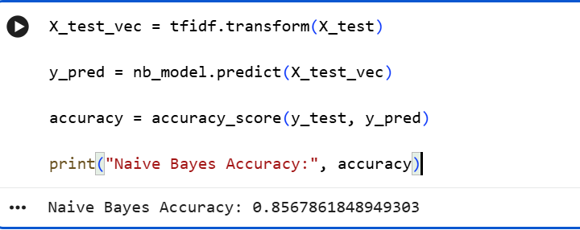
Naive Bayes Accuracy
11

Slide 14
Why Not Logistic Regression?
Model selection was based on reliability, not only accuracy
Logistic Regression tested
Decision
• High initial accuracy around 94%
• But predictions appeared biased toward one class
• Outputs became over-confident on some unseen samples
• Naive Bayes selected as final model
• More stable behavior for this project
• Better balance for unseen text samples
12

Slide 15
Preprocessing
Preparing raw CSV text for machine learning
Raw CSV
Remove Nulls
Clean Text
Keep Columns
• Removed rows with missing values.
• Cleaned article text before vectorization.
• Selected only text as input and label as target.
13

Slide 16
Feature Engineering
Text must be converted into numeric form before training
TF-IDF Vectorization
• Converts each article into a numerical vector.
• Represents word importance across the whole corpus.
• Produces sparse vectors suitable for MultinomialNB.
14

Slide 17
Why TF-IDF?
Term importance is more informative than raw word presence
Term Frequency
Inverse Document Frequency
Weighted Features
• Gives more weight to important words.
• Reduces the effect of very common words.
• Ideal for many traditional NLP classifiers.
15

Slide 18
Train-Test Split
A standard split was used to test generalization
80%
20%
Training Data
Testing Data
• Training set teaches the model.
• Testing set evaluates performance on unseen data.
16

Slide 19
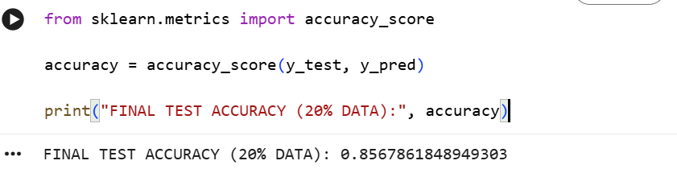
Accuracy On Split of 20% Test Data

Slide 20
Model Workflow
End-to-end prediction pipeline
Input News Text
TF-IDF Conversion
Naive Bayes
REAL / FAKE
17

Slide 21
Model Parameters
Simple probabilistic model with limited tuning complexity
P(class | text)
• Model: Multinomial Naive Bayes.
• Type: Probabilistic classifier.
• Uses word-feature likelihoods to estimate class probability.
• No complex neural-network hyperparameters required.
18

Slide 22
Model Size
Lightweight artifacts are suitable for deployment
naive_bayes_model.pkl
Prediction App
Reusable
tfidf_nb.pkl
• The classifier and vectorizer are saved separately.
• The system can make predictions without retraining.
19

Slide 23
Model Saving
Joblib stores the trained components as files
joblib.dump(nb_model, "naive_bayes_model.pkl")
joblib.dump(tfidf, "tfidf_nb.pkl")
• The trained classifier is saved as naive_bayes_model.pkl.
• The fitted TF-IDF vectorizer is saved as tfidf_nb.pkl.
20

Slide 24
Model Loading
Saved files are loaded for prediction or deployment
model = joblib.load("naive_bayes_model.pkl")
tfidf = joblib.load("tfidf_nb.pkl")
• Both files must be loaded together.
• The vectorizer transforms input text in the same way as training.
21

Slide 25
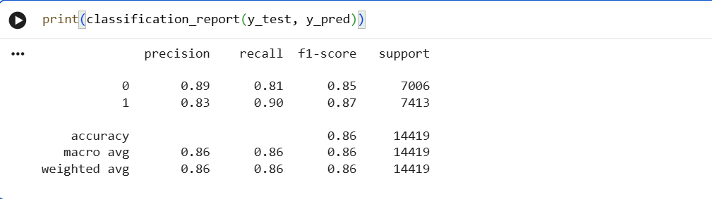
Evaluation Metrics
Performance was checked from multiple angles
Accuracy
Confusion Matrix
Precision
Recall
F1 Score
Macro avg and weighted avg are both 0.86, showing balanced overall performance.
22

Slide 26
Why These Metrics?
Each metric explains a different part of model performance
Metric meaning
Balanced view
• Accuracy shows overall correctness.
• Confusion matrix shows error types.
• Precision shows quality of fake/real predictions.
• Recall shows how many true cases are detected.
• F1-score balances precision and recall.
• Together they reveal stability better than accuracy alone.
23

Slide 27
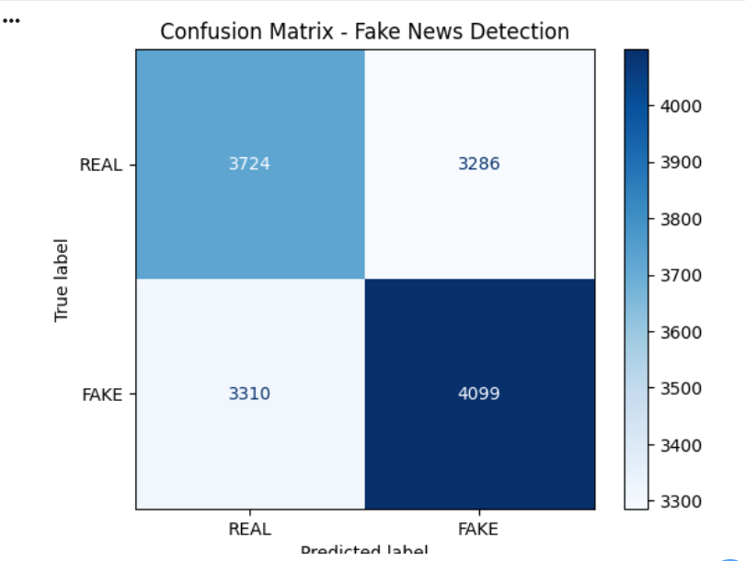
Confusion Matrix
Predicted Class
TN
FP
Actual
Class
FN
TP
Correct predictions are on the diagonal: 5666 real + 6688 fake.
24

Slide 28
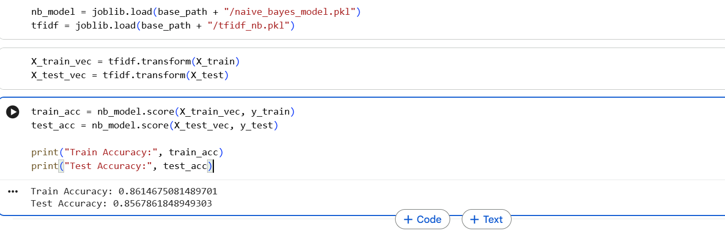
Accuracy Results
Train and test performance are close
86.1%
85.7%
Train Accuracy
Test Accuracy
25

Slide 29
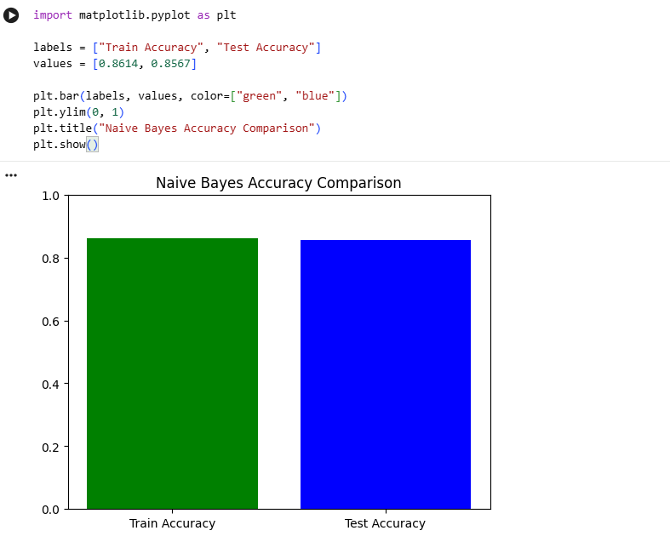
Train vs Test Accuracy Graph
25

Slide 30
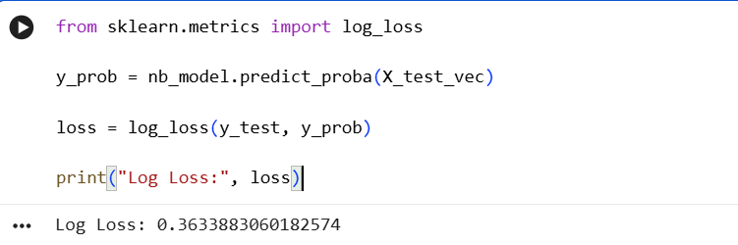
Loss Function Explanation
Naive Bayes is not trained with gradient-descent loss curves
• Naive Bayes estimates probabilities directly from training data.
• It is not a gradient-based model like neural networks.
• Therefore, it does not produce a traditional loss curve.
• Evaluation can use accuracy, F1-score, and log-loss.
Log-Loss Evaluation Output
Computed test log-loss: 0.3634
26

Slide 31
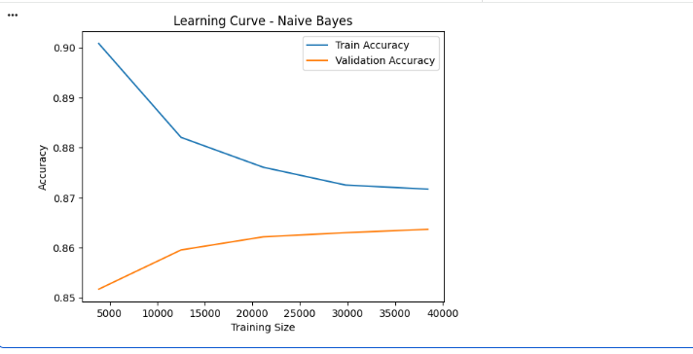
Learning Curve
Optional check for stability as training data increases
Actual Learning Curve Output
The curve should flatten as more data is added, showing that the model has learned a stable pattern.
Interpretation
Validation accuracy improves as training
size increases and then becomes stable.
27

Slide 32
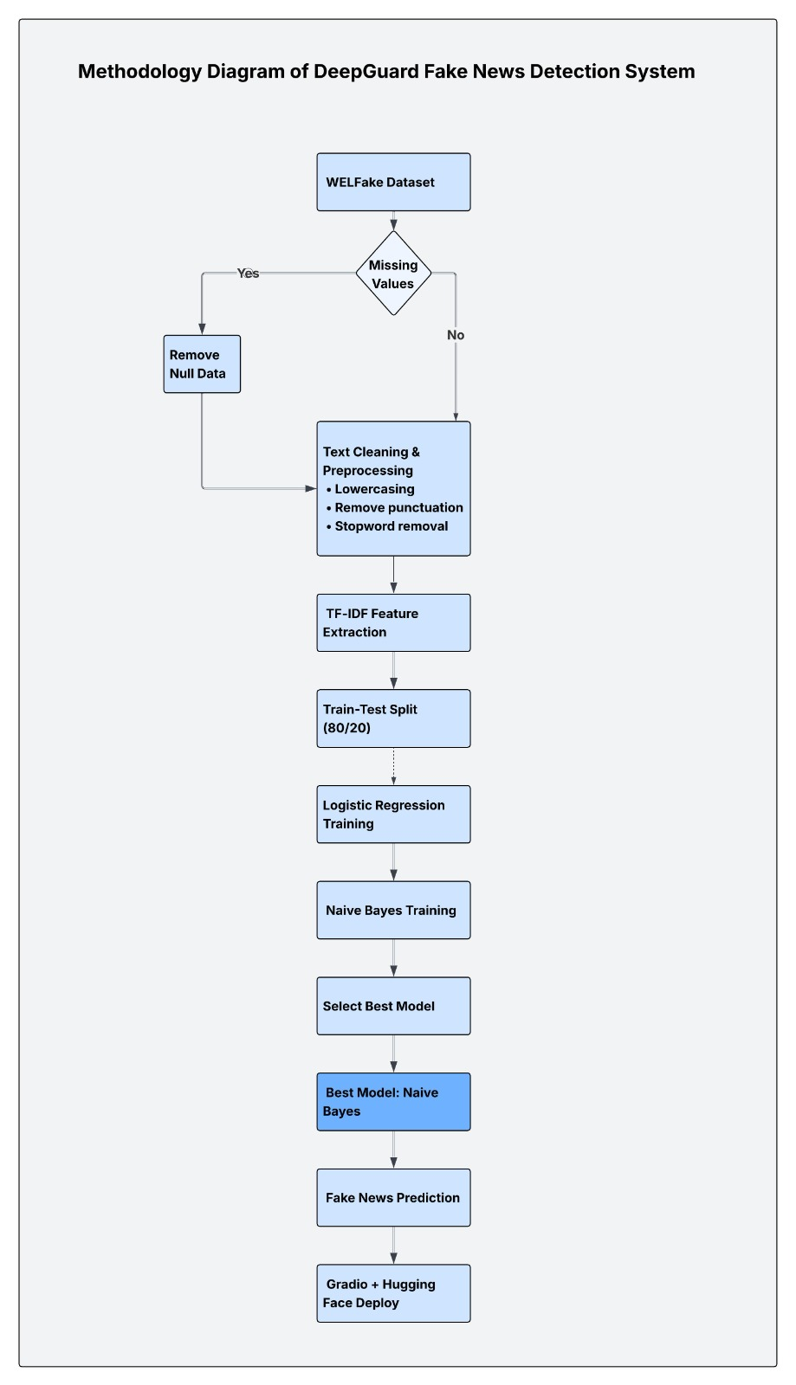
Methodology
28

Slide 33
Final Testing
The final model was tested on unseen text samples
Test approach
Observed output
• Entered new news text samples.
• Converted text using saved TF-IDF vectorizer.
• Predicted label using saved Naive Bayes model.
• Correct classification for real news samples.
• Correct classification for fake news samples.
• Prediction returned as REAL or FAKE.
30

Slide 34

Deployment
Saved artifacts can be reused in a simple application
• Model saved using Joblib.
• TF-IDF vectorizer saved separately.
• Application loads both files and predicts new inputs.
• No retraining is needed during normal use.
31

Slide 35
Conclusion
Naive Bayes successfully detects fake news from article text.
• The model is lightweight, interpretable, and suitable for deployment.
• TF-IDF helped convert text into meaningful numerical features.
• Train and test accuracy were close, suggesting stable performance.
85.7%
Final Test Accuracy
32

Slide 36
Future Work
Deep Learning Models
LSTM / BERT
Real-time Social
Media Detection
Multi-language
Fake News Detection
• Improve semantic understanding using transformer-based models.
• Connect the system to live social media streams.
• Extend the project to Urdu and other regional languages.
33

Slide 37
Implementation Evidence: Model Results
Screenshots captured from the Colab notebook after training and testing Naive Bayes
34

Slide 38
Classification Report

Slide 39
Log Loss + Accuracy Outputs

Slide 40
Learning Curve

Slide 41
Thankyou
33

